Slide 1
Voltaire’s Philosophical Dictionary Project
H. Fahad
S. Silwal
Y. Malla

Slide 2
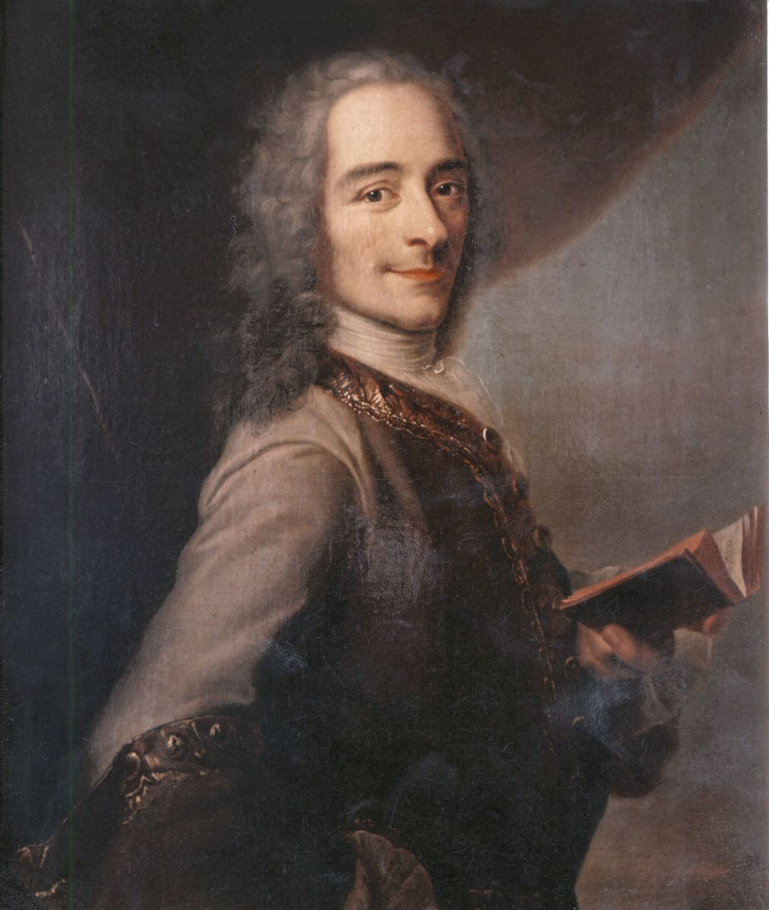
INTRODUCTION
Real Name: Francois-Marie Aironet
Pen Name: Voltaire
Born: 1694 in France, a time when Louis XIV. was the king
One of the leading writers of the Enlightenment
Criticized the role of Roman Catholic Church
Strong advocate of liberal society
Impressed by the works of the Enlightenment philosophers like Isaac Newton, John Locke and Francis Bacon, so much that he later himself became an Enlightenment writer.
Did a tremendous job in writing historical and philosophical works

Slide 3
Voltaire’s Dictionnaire Philosophique is an important work about concepts of Enlightenment
It is a dictionary as well as an encyclopedia where we see how Voltaire rejects ideas of the Roman Catholic Church.
As he exposed the church, his works were considered as rebellious, and he had to face the anger of the French ruling class as well as the French Church.
The Philosophical Dictionary is a collection of essays published by Voltaire in 1764.
Its articles are alphabetically arranged and often criticize the Roman Catholic Church and other institutions.
It was a lifelong project for Voltaire and represents the culmination of his views on Christianity, God, morality, and other subjects
English philosophy influenced him a lot, which led him to become a great philosopher.
On his exile from 1726-1729, he stayed in England
He met some great English men like Alexander Pope, Jonathan Swift, George Berkely, and Samuel Clarke
These men and the liberalism of the English institutions greatly influenced him, and he led to the conclusion that English society is able to produce great scientists like Sir Isaac Newton and philosophers like John Locke because of liberalism
Later, when he returned to France, he tried to apply these knowledge and skills in France, which he learned in England.

Slide 4
The purpose of the dictionary was to act as a guide for individuals and society.
The completion of the Philosophical Dictionary was a significant milestone of the Enlightenment.
It emphasized on freedom of speech, religion and how a religion should have nothing to do with the affairs of the state.
Voltaire wanted to expose the church and its hypocrisy.
Voltaire fantastically defines the concepts using out of the box techniques:
Sometimes he narrates a story to give the sense.
Sometimes he becomes satirical to provide the purpose.
Sometimes he takes an account from the Bible and adds his commentary to it.
Some examples of how Voltaire defines terms and concepts in his Philosophical Dictionary:
Voltaire tells us about “advocate” as the one who studies the laws of Theodosius and Justinian for three years and therefore, gets the right to plead causes for money.
He criticizes the concept of “destiny”, which is given by the church.
He says that the church tells us how everything that happens in our life is prewritten. But his point is if whatever we do is written, how can we be held responsible for that deed which we were supposed to do in anyways? So he says that the idea of destiny given by church is beyond logic.

Slide 5
He also defines the word “Devout” which means devoted, but was associated with monks and nuns only. Voltaire argues that everything should be equally righteous and that monks or nuns have no right to consider themselves more worthy or more devoted than a common man.
While talking about “faith” in his Philosophical Dictionary, Voltaire says that faith makes people blind in their beliefs.
When Voltaire talks about “Equality” in his Philosophical Dictionary, he makes argument that one has to appreciate his feelings towards the entire humanity. He argues that equality should mean that all men and women are equal, they were created equal by the creator, and they should be treated equally on this planet.
Talking about “Democracy” in his Philosophical Dictionary, Voltaire takes into account different political systems the world has seen so far and how the system of democracy was reached after trying and testing other different systems. Democracy is, so now, the best system for humanity and freedom is the result of many experiments.

Slide 6
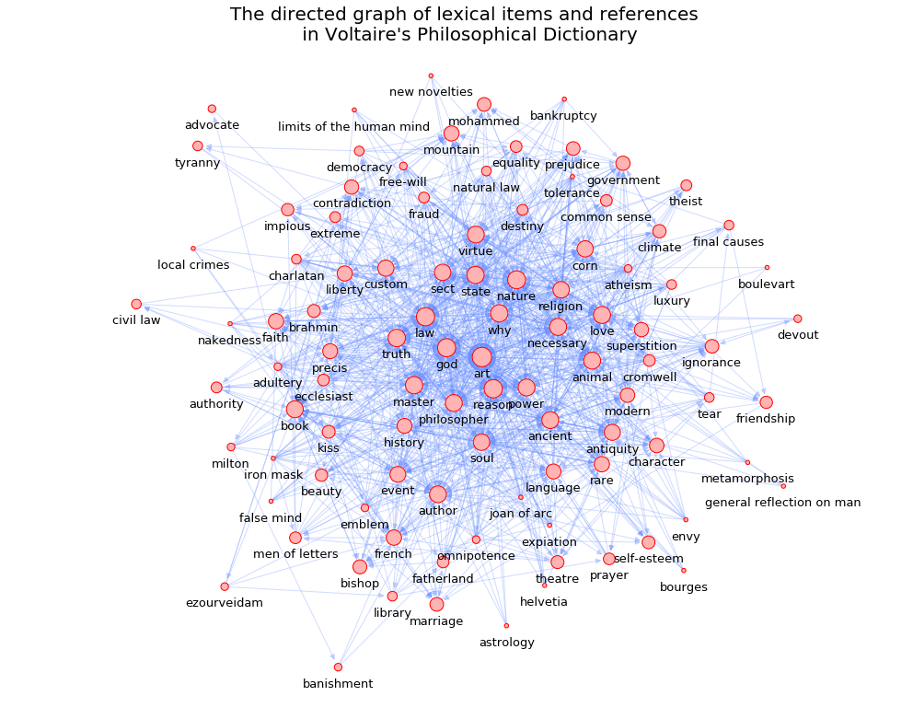
GRAPH OF LEXICAL ITEMS AND REFERENCES

Slide 7
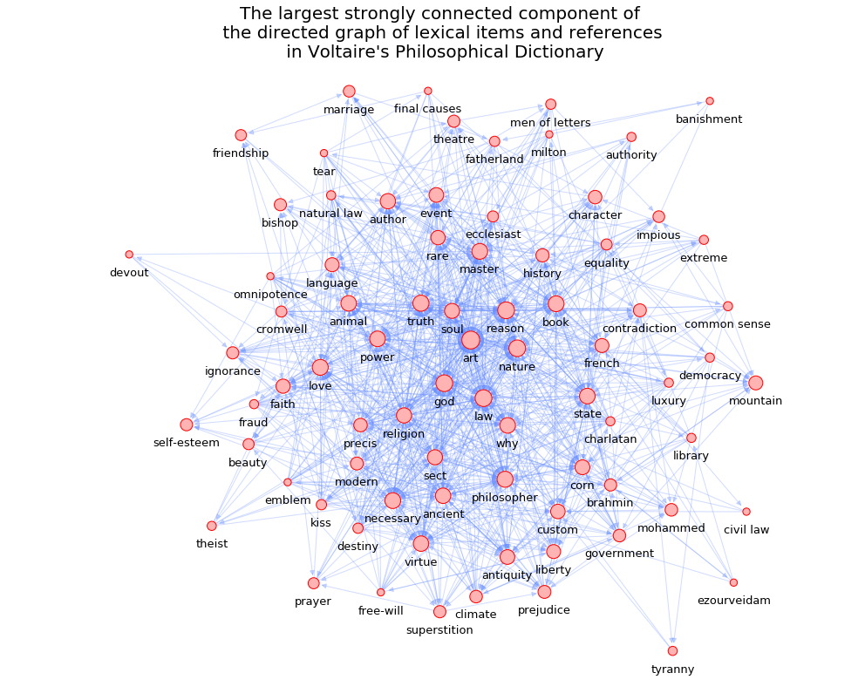
LARGEST STRONGLY CONNECTED COMPONENT OF GRAPH OF LEXICAL ITEMS AND REFERENCES

Slide 8
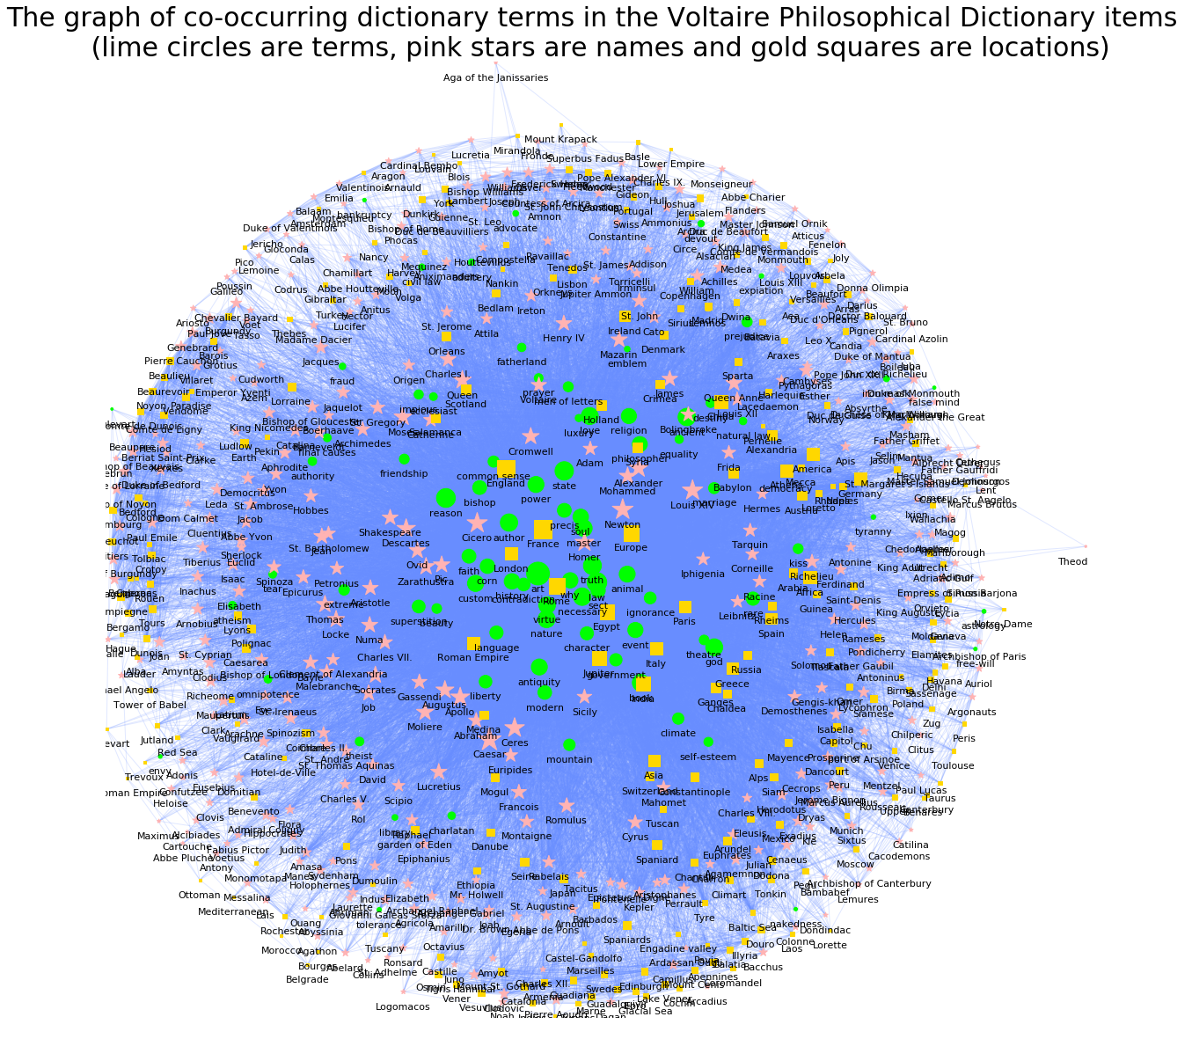
GRAPH OF CO-OCCURRING TERMS, CHARACTER NAMES AND LOCATIONS IN THE DICTIONARY ITEMS

Slide 9
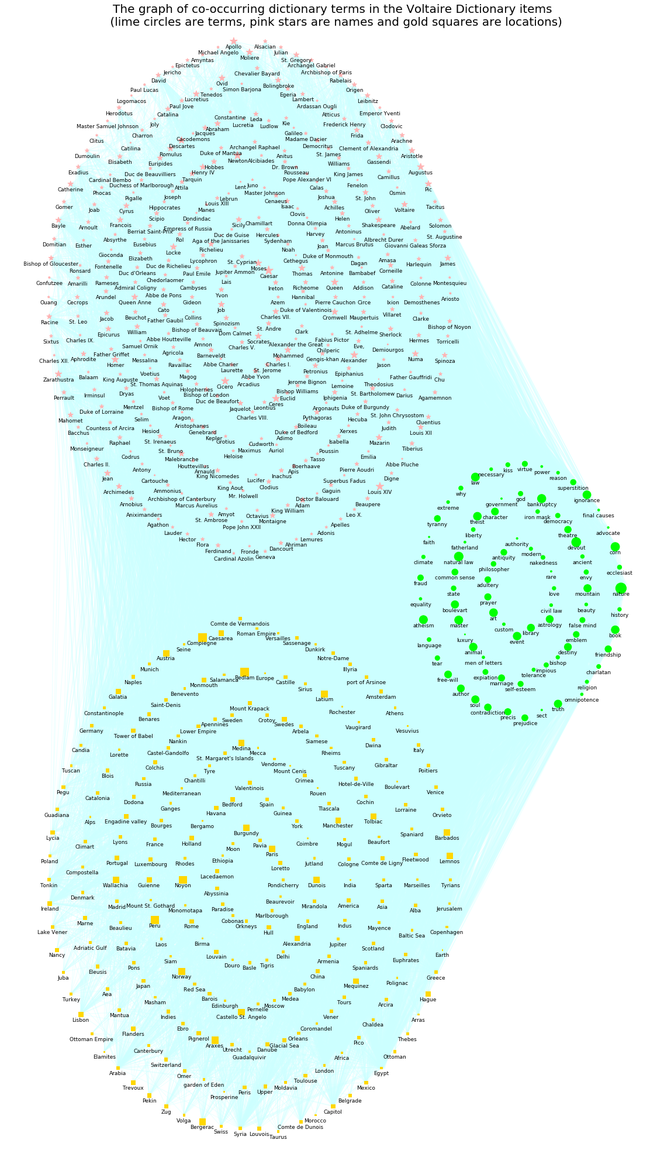

Slide 10
GRAPH OF CO-OCCURRING CHARACTER NAMES IN THE DICTIONARY ITEMS

Slide 11
GRAPH OF CO-OCCURRING LOCATION NAMES IN THE DICTIONARY ITEMS

Slide 12
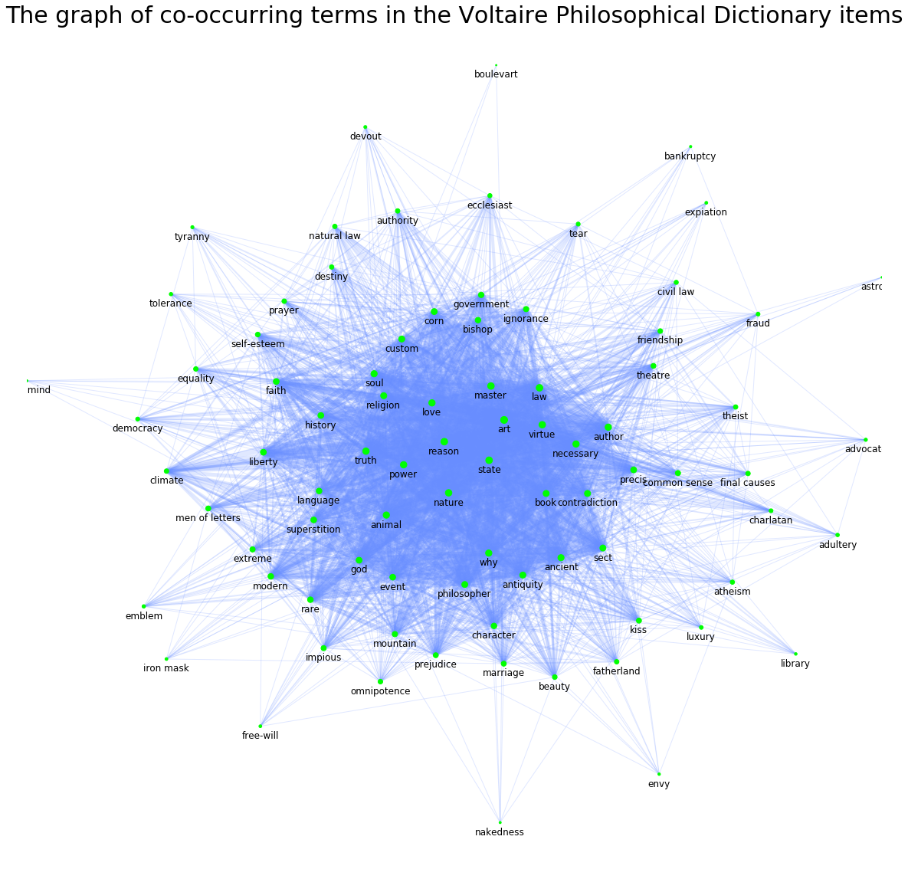
GRAPH OF CO-OCCURRING TERMS IN THE DICTIONARY ITEMS

Slide 13
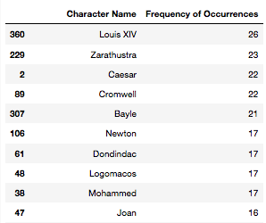
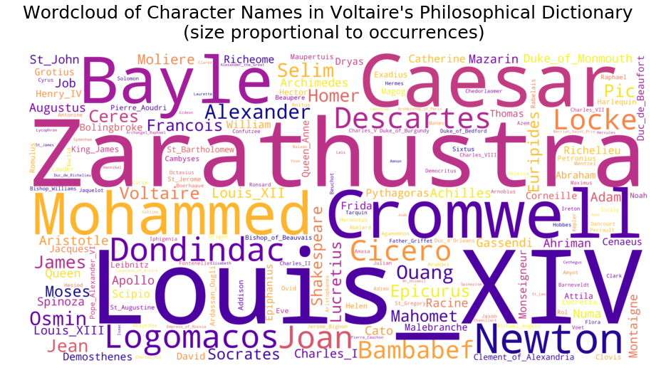
WORD CLOUD OF CHARACTER NAMES

Slide 14
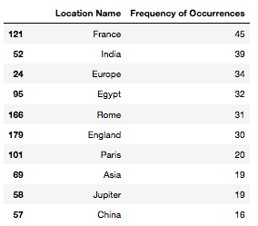
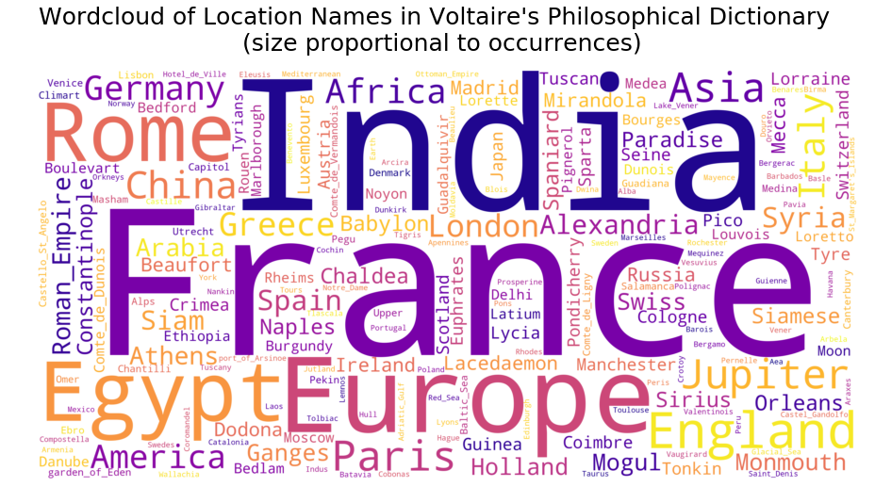
WORD CLOUD OF LOCATION NAMES

Slide 15
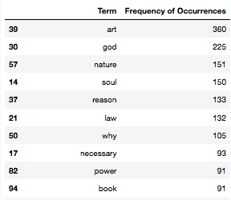
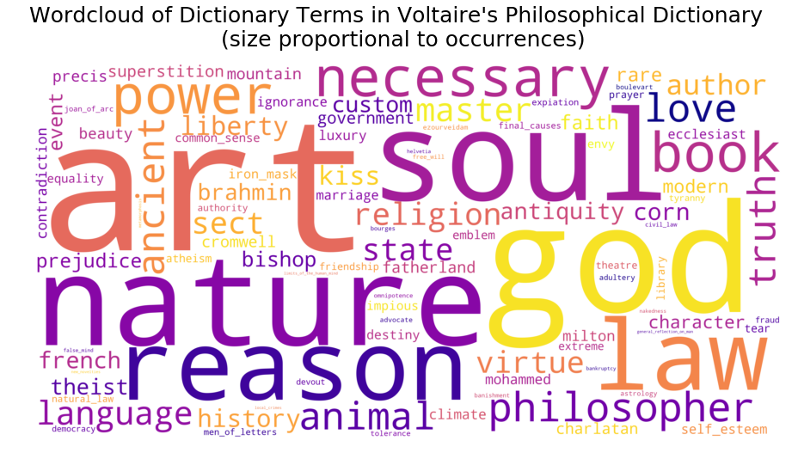
WORD CLOUD OF LEXICAL TERMS

Slide 16
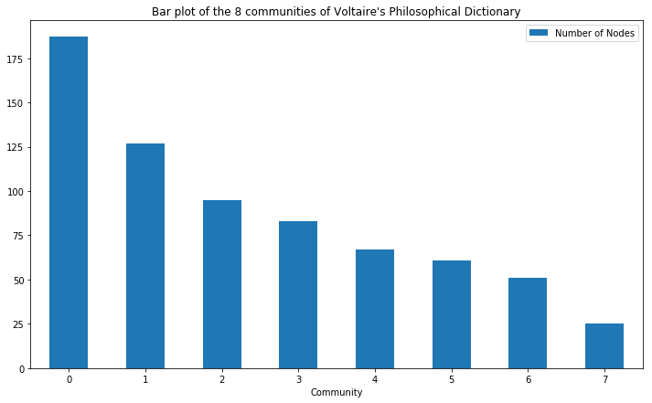
BAR PLOT OF COMMUNITIES OF VOLTAIRE’S PHILOSOPHICAL DICTIONARY GRAPH

Slide 17
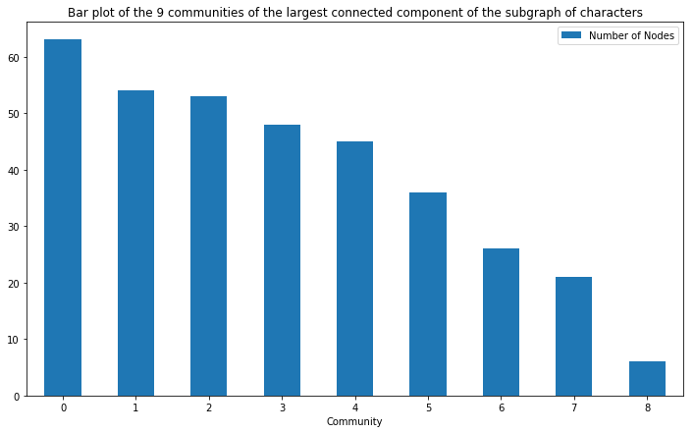
BAR PLOT OF COMMUNITIES OF THE LARGEST CONNECTED COMPONENT OF SUBGRAPH OF CHARACTER NAMES

Slide 18
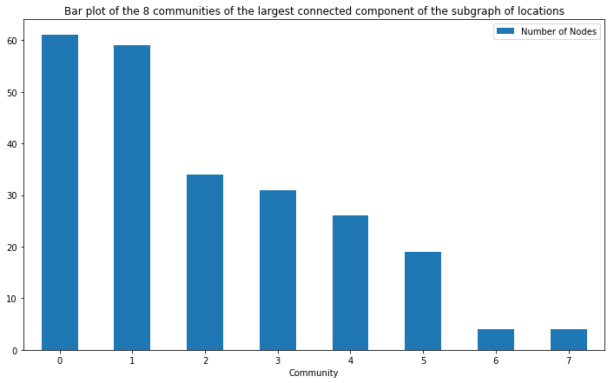
BAR PLOT OF COMMUNITIES OF THE LARGEST CONNECTED COMPONENT OF SUBGRAPH OF LOCATION NAMES

Slide 19
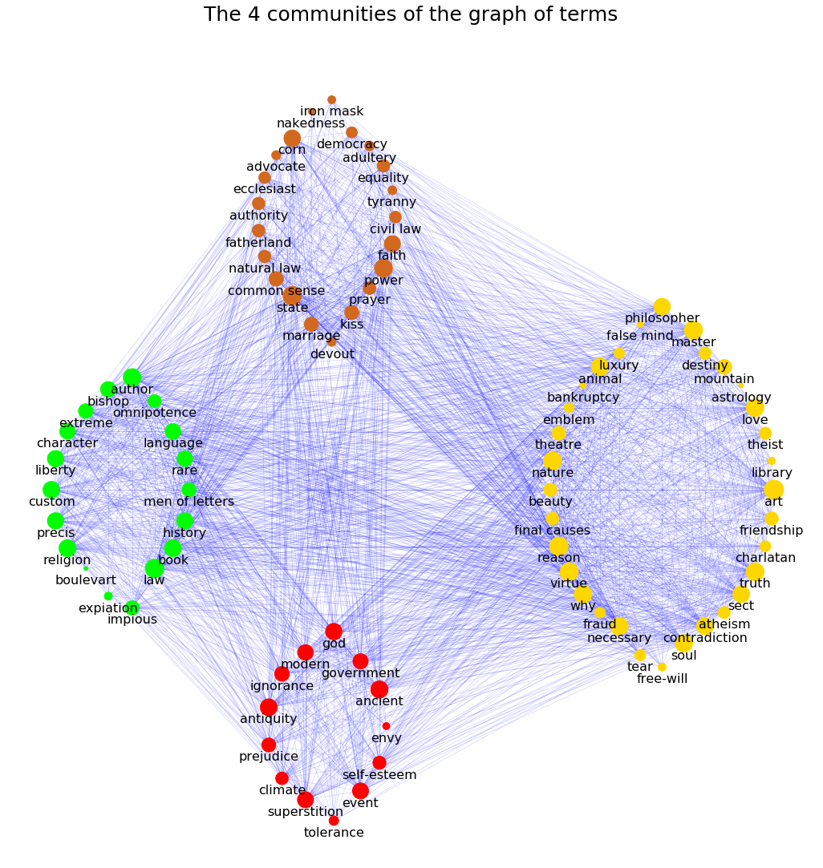
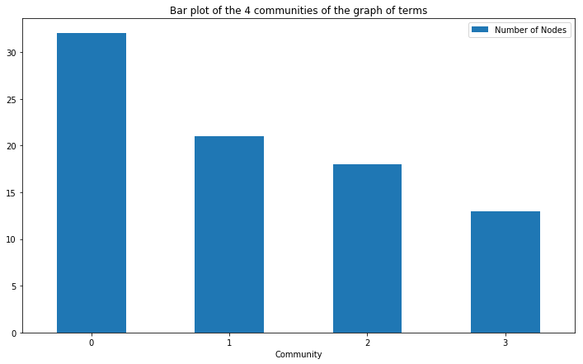
BAR PLOT OF COMMUNITIES OF THE SUBGRAPH OF LEXICAL TERMS

Slide 20
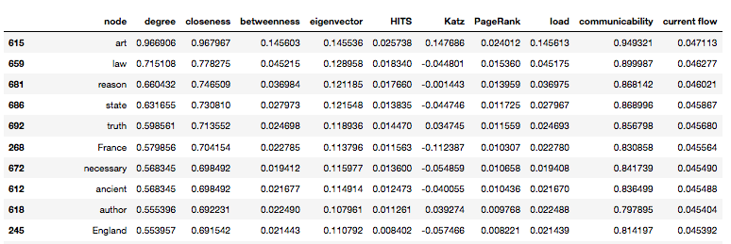
DATAFRAME FOR CENTRALITIES OF VOLTAIRE’S PHILOSOPHICAL DICTIONARY GRAPH

Slide 21
Questions?
THANK YOU!

